Slide 1

Car Market Insights
What Makes a Used Car Worth More?
Name : Yash Sanjay Monde
Aicte ID : STU69f055805a3e71777358208

Slide 2

PROBLEM STATEMENT
The Challenge: Used car prices depend on age, mileage,fuel type, ownership, and seller type, but listings are rarely priced consistently.
Core Question: Which car features actually drive resale prices and which ones do not?

Slide 3
Dataset Overview
Source: CarDekho used-car listings (299 clean records after removing duplicates).
Data Quality: Complete dataset with zero missing values across all columns.
Key Columns: Car Name, Year, Selling Price, Present Price, Kms Driven, Fuel Type, Seller Type, Transmission, and Owner.

Slide 4

WHO ARE THE END USERS?
Used-car buyers - Benchmark whether an asking price is fair given age, mileage and ownership history.
Individual sellers - Set realistic prices instead of anchoring on original purchase price.
Dealerships - Use fuel type, ownership tier and mileage bucket as pricing levers when acquiring/reselling stock.
Online marketplaces (e.g: CarDekho) - Feed these variables into an automated valuation/pricing model
Analysts/data teams – A reference EDA for a resale-value prediction model (features and correlations already scoped).

Slide 5

Technology Used
Pandas: Data loading, cleaning, and manipulation.
Matplotlib & Seaborn: Data visualization and chart generation.
Microsoft PowerPoint: Reporting and presentation of key insights.

Slide 6
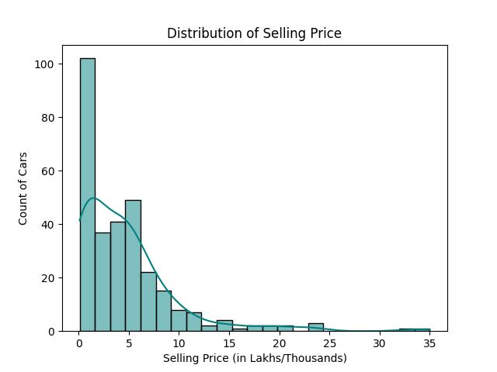
Selling Price Distribution
Finding No -1
Most cars are affordable: The majority of cars sell in the ₹0–5 Lakh range.
Averages can be misleading: The average price (₹4.66L) is pulled up by a few high-value listings.
Key takeaway: Use the median price (₹3.60L) as a realistic benchmark for typical car pricing.

Slide 7
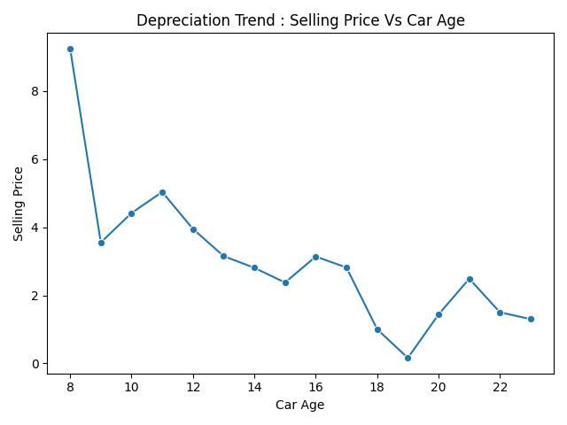
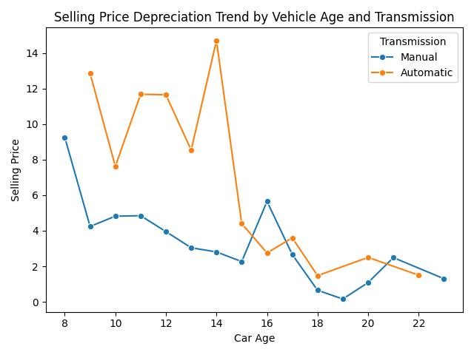
Depreciation Trend by Car Age and Transmission
Finding No -2
Steep Early Price Drop: Car prices decline sharply from age 8 to 15, dropping from ~9.8L down to under 3L.
Strong Automatic Premium: Automatic cars retain significantly higher market values than manual cars up to 14 years of age.
Convergence After 15 Years: Beyond 15 years, the price gap between automatic and manual models disappears, and values fluctuate due to fewer listings.

Slide 8
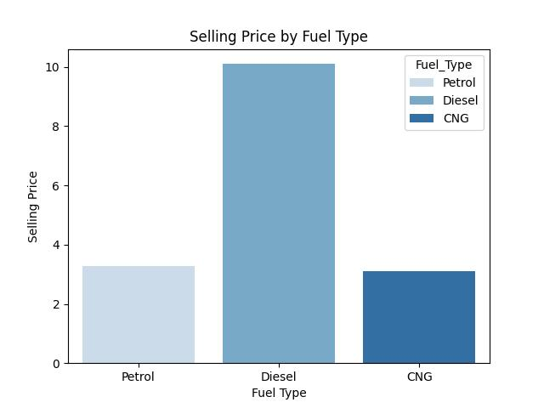
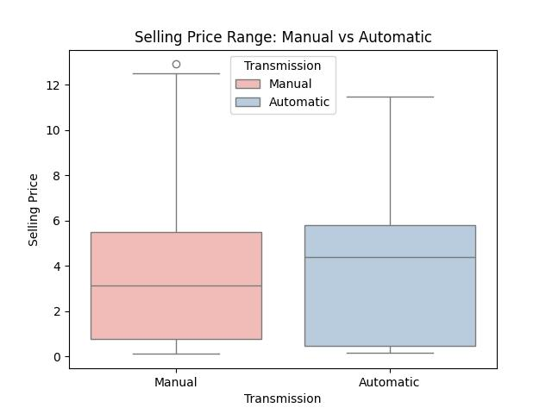
Fuel Type &Transmission Premium
Finding No -3
Diesel commands a higher price: Diesel cars sell for more than double the price of Petrol and CNG models (~₹6.9L vs ~₹3.0L).
Automatics cost more: Automatic transmissions add an extra value premium over manual options.
Key takeaway: Fuel type and transmission are major drivers of higher selling prices.

Slide 9
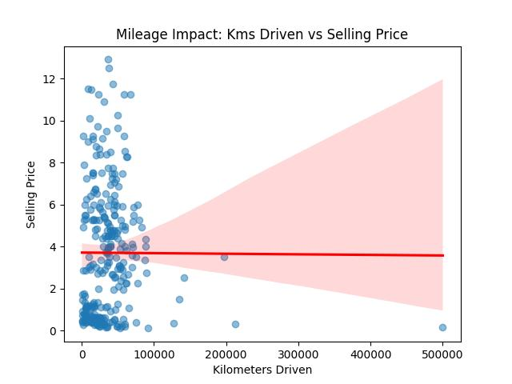
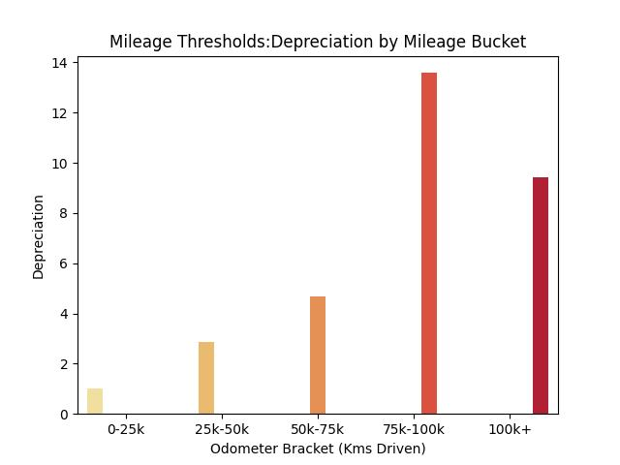
Mileage: A Weaker Predictor Than Expected
Finding No - 4
Total kilometers don't tell the whole story: Raw mileage alone does not cause a direct, straight-line price drop.
Price drops happen in brackets: Significant depreciation occurs once a car crosses key mileage thresholds, especially between 75k–100k km.
Key takeaway: Grouping mileage into ranges is a safer way to evaluate value loss.

Slide 10
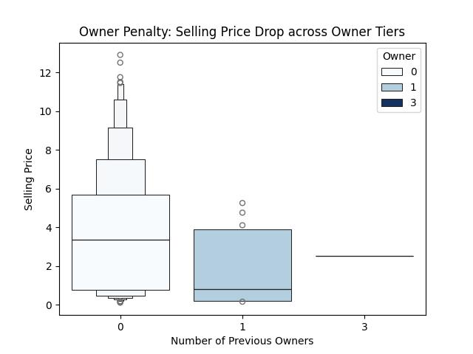
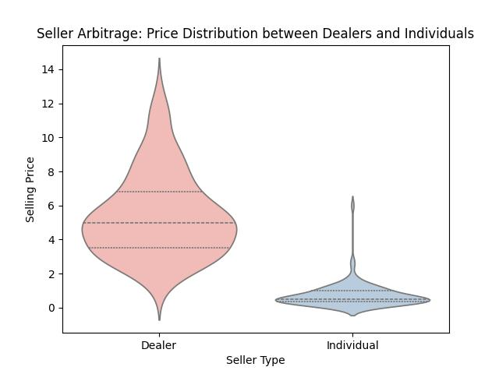
Ownership History & Seller Type
Finding No - 5
First-owner cars hold better value: Cars with zero previous transfers sell for noticeably higher prices than multi-owner cars.
Dealers list higher-value cars: Dealers average much higher selling prices (₹4.98L) compared to individual sellers (₹0.51L).
Key takeaway: Dealers tend to stock newer, premium inventory rather than simply charging higher markups.

Slide 11
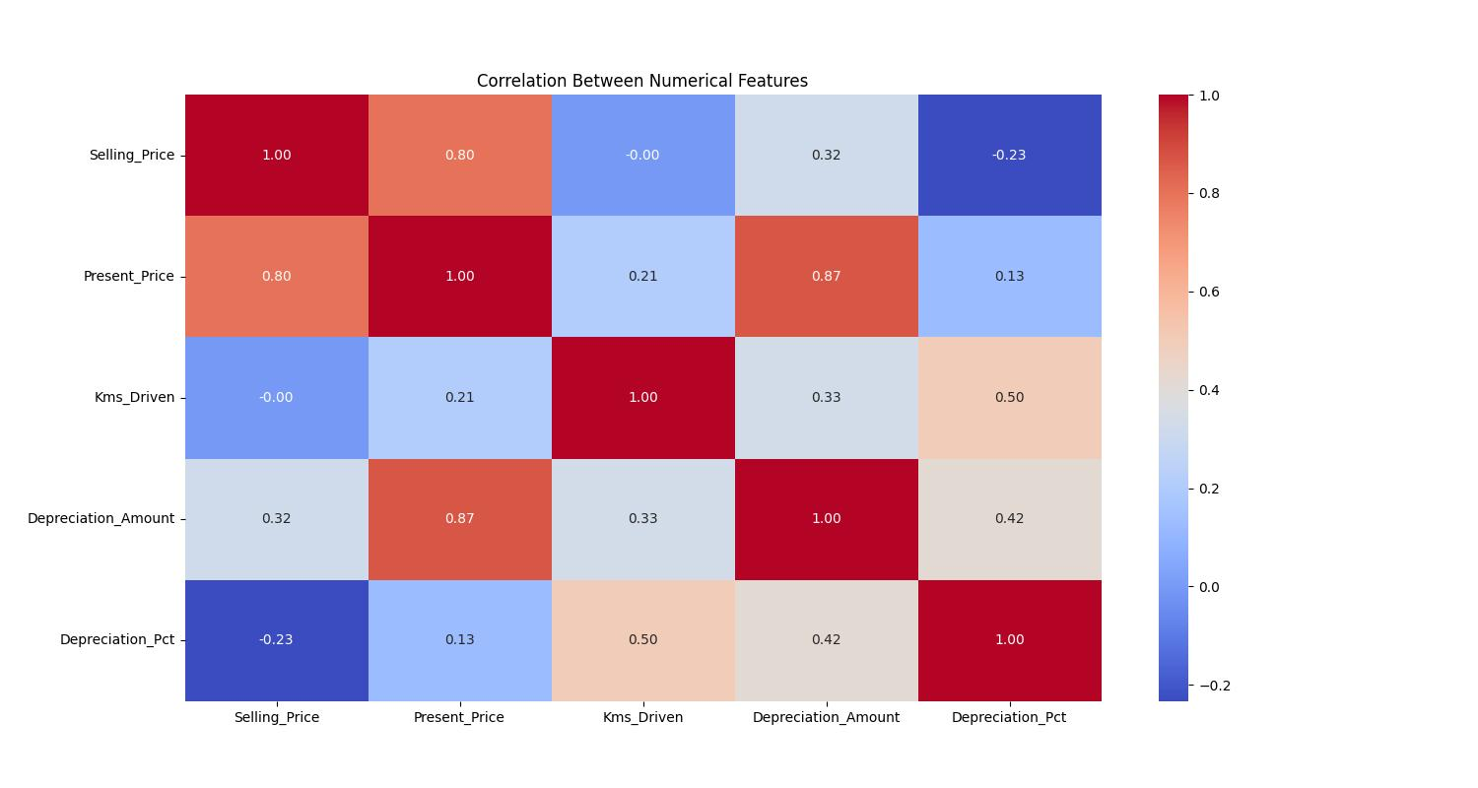
What Actually Correlates with Price
Finding No - 5
Original price is the biggest factor: The original new price (Present_Price) is the strongest indicator of a car's used value (0.80 correlation).
Mileage affects percentage loss: Kilometers driven better predict the percentage of value lost rather than the raw selling price.
Key takeaway: Start with the car's original brand/new price to determine its base resale

Slide 12
GitHub Link
Project Repository & Source Code :
All code files, clean datasets and analysis notebooks for this project are completely open-source and hosted on GitHub.
Repository Link
Url : https://github.com/yashmonde24/car-market-insights
What You Will Find in the Repository:
python/ : Source code and Jupyter notebooks for data cleaning, EDA and generating visualization charts.
docs/ : A clean, presentation-ready slide deck outlining our main findings and recommendations for non-technical stakeholders.
.data/ : CarDekho used-car dataset used for performing the analysis.
README.md : A detailed, step-by-step project guide featuring the exact visual charts and actionable recommendations shown.

Slide 13
Thank you
Car Market Insights
What Makes a Used Car Worth More?
  Any Questions ?
  Feel free to share your thoughts, feedback or questions regarding the data insights.
  Presenter Contact Information :
Name : Yash Sanjay Monde
Email : realyashmonde956@gmail.com
GitHub / Portfolio : https://github.com/yashmonde24
.
.

